Slide 1
Stable Matching Problem
Gale-Shaply Algorithm

Slide 2


From problem to software
CSE331

Slide 3
Main Steps in Algorithm Design
Problem Statement
Real world problem
Problem Definition
Precise mathematical def
Algorithm
Implementation
Data Structures
Analysis
Correctness/Run time

Slide 4
Worst-case analysis (CSE250)
Correctness should hold for every valid input
Why worst-case?
Resource usage by the worst-possible input
What resources?

Slide 5
Stable Matching Problem
Problem Statement
Problem Definition
Algorithm
Implementation
Analysis

Slide 6






Docs are coming to BUF
Buffalo General
Hawkeye (M*A*S*H)
Millard Filmore (Gates Circle)
JD (Scrubs)
Millard Filmore (Suburban)

Slide 7
What can go wrong?
Buffalo General
Hawkeye (M*A*S*H)
Millard Filmore (Gates Circle)
JD (Scrubs)
Millard Filmore (Suburban)

Slide 8
The situation is unstable!
Buffalo General
Hawkeye (M*A*S*H)
Millard Filmore (Gates Circle)
JD (Scrubs)
Millard Filmore (Suburban)

Slide 9
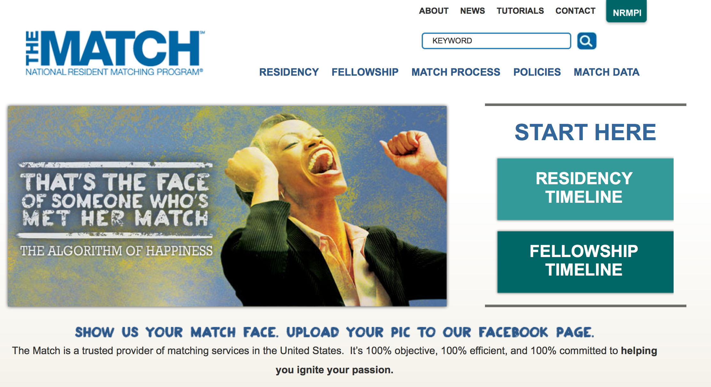
National Resident Matching (http://www.nrmp.org/)

Slide 10

What happens in real life
Preferences
Information
Preferences

Slide 11
NRMP plays matchmaker

Slide 12
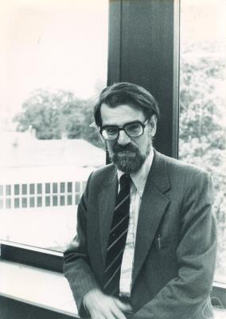
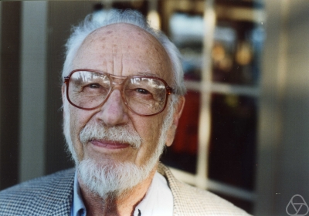
Stable Marriage/Matching Problem
David Gale
Lloyd Shapley

Slide 13
Stable Matching Problem
Problem Statement
Problem Definition
Algorithm
Implementation
Analysis

Slide 14



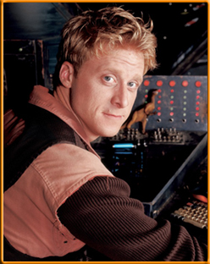


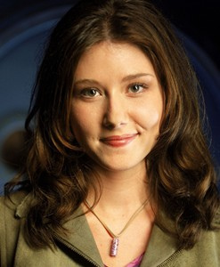
On matchings
Mal
Inara
Wash
Zoe
Simon
Kaylee

Slide 15
Questions to Setup/Simplify SMP
Q1) How do we specify preferences?
Q2) What is the ratio of men to women?
Q3) Can a man marry more than one woman?
Q4) Can a woman marry more than one man?
Q5) How many men/women in a preference list?
Q6) Does every man marry at least 1 woman?
Q7) Does every woman marry at least 1 man?
Q8) How do we define an assignment?

Slide 16
Questions to Setup/Simplify SMP
Q1) How do we specify preferences?
List of preferences (ranking)
Q2) What is the ratio of men to women?
1:1 (n men and n women)
Q3) Can a man marry more than one woman?
No polygamy
Q4) Can a woman marry more than one man?
No polygamy

Slide 17
Questions to Setup/Simplify SMP
Q5) How many men/women in a preference list?
All n of them
Q6) Does every man marry at least 1 woman?
Yes (no singles)
Q7) Does every woman marry at least 1 man?
Yes (no singles)

Slide 18
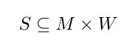
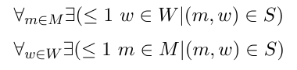
Q8) How do we define an assignment?
An assignment is a matching which is a set
M is the set of men: M = {m₁, m₂, … , m_{n}}
W is the set of women: W = {w₁, w₂, … , w_{n}}
No polygamy
Ex. (n=2) S = {(m_{2,} w₁), (m₁, w₂)}

Slide 19
Types of matching
Matching:
No polygamy (defined on previous slide)
Perfect matching (no singles):
S is a matching and |S| = n
Stable matching:
A perfect matching with no instabilities
Instability:
There exists an (m, w) not in S such that both
m prefers w over his current spouse and
w prefers m over her current spouse

Slide 20
A valid matching
Mal
Inara
Wash
Zoe
Simon
Kaylee

Slide 21
Not a matching
Mal
Inara
Wash
Zoe
Simon
Kaylee

Slide 22
Perfect Matching
Mal
Inara
Wash
Zoe
Simon
Kaylee

Slide 23
Preferences
Mal
Inara
Wash
Zoe
Simon
Kaylee

Slide 24
Instability
Mal
Inara
Wash
Zoe
Simon
Kaylee

Slide 25
Stable Matching
Mal
Inara
Wash
Zoe
Simon
Kaylee

Slide 26
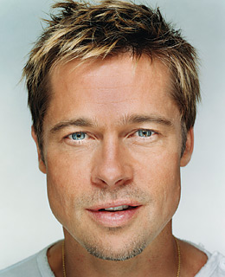
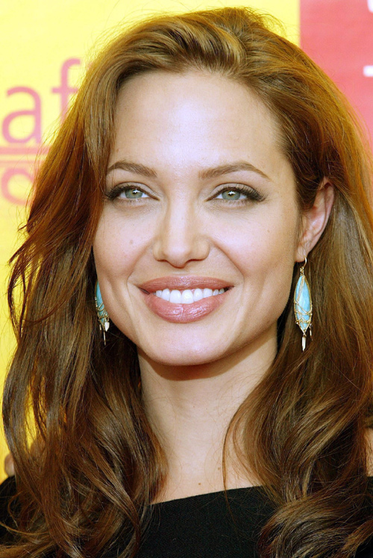
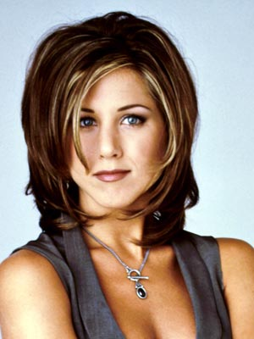
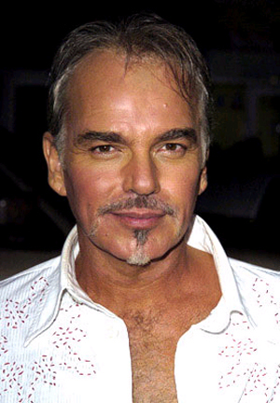
A stable marriage
Even though BBT and JA are not very happy

Slide 27
Two stable matchings

Slide 28
Stable Marriage problem
Input: M and W with preference lists
Output: A stable matching from M x W

Slide 29
How would you solve this problem?
Discussion

Slide 30
Stable Matching Problem
Problem Statement
Problem Definition
Algorithm
Implementation
Analysis

Slide 31
Two Questions
Does a stable marriage always exist?
If one exists, how quickly can we
compute one?

Slide 32
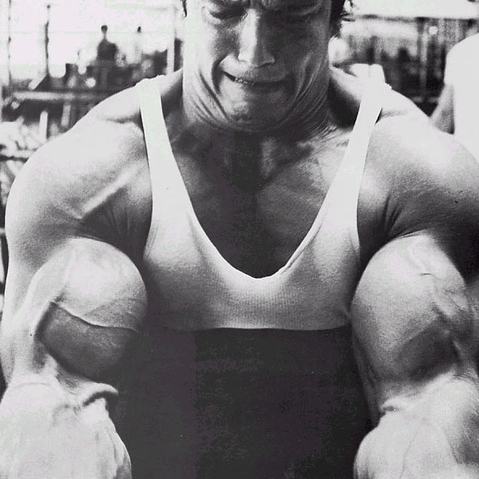
A naïve algorithm
Go through all possible perfect matchings S
If S is a stable matching
return S
n! matchings
Else move to the next perfect matching

Slide 33
Gale-Shapley Algorithm
David Gale
Lloyd Shapley
O(n³) algorithm

Slide 34
Gale-Shapley Algorithm
Women do all the proposing (different from the book)
Everyone is in one of three states: free, engaged, or married
Step 1: A free woman w proposes to her most preferred man m. (m,w) get engaged
General step: A free woman w proposes to her top unproposed man m.

Slide 35
Gale-Shapley Algorithm
Initially all men and women are free
While there exists a free woman who can propose
Let w be such a woman and m be the best man she has not proposed to
w proposes to m
If m is free
(m,w) get engaged
Else (m,w’) are engaged
If m prefers w’ to w
w remains free
Else
(m,w) get engaged and w’ is free
Output the engaged pairs as the final output. These engaged pairs get married.

Slide 36
Preferences
Mal
Inara
Wash
Zoe
Simon
Kaylee

Slide 37
GS algorithm: Firefly Edition
Mal
Inara
Wash
Zoe
1
2
3
4
5
6
Simon
Kaylee
1
2
3
4
5
6

Slide 38
Stable Matching Problem
Problem Statement
Problem Definition
Algorithm
Implementation
To the code
Analysis

Slide 39
Moral of the story…
>

Slide 40
Stable Matching Problem
Problem Statement
Problem Definition
Algorithm
Implementation
Analysis

Slide 41
Proof of Correctness: Gale-Shaply

Slide 42

Proof technique de jour
Proof by contradiction
Assume the negation of what you want to prove
After some reasoning
Source: 4simpsons.wordpress.com

Slide 43
CSE191 Flavor
Prove there are infinitely many prime numbers
Assume there are finitely many primes and call them P = {p₀, p₁, …, p_{n}}
Consider the number q = p₀p_{1…}p_{n} + 1
The number q is not in P and is therefor composite
As such, q must be divisible by some p_{i} in P
However, q/p_{i} has a remainder of 1 for all p_{i} in P
Therefore, q is prime which is a contradiction
There must be infinitely many primes!

Slide 44
Now a CSE331 flavor proof by contradiction

Slide 45
GS algo outputs a stable matching
Lemma 1: GS outputs a perfect matching S
Lemma 2: S has no instability

Slide 46
Two obervations
Obs 1: Once m is engaged he keeps getting
engaged to “better” women
Obs 2: If w proposes to m’ first and then to m
(or never proposes to m) then she
prefers m’ to m

Slide 47
Proof of Lemma 1
Lemma 1: GS outputs a perfect matching S
Assume S is not a perfect matching
There exists a woman w who is single
The woman w must have proposed to all n men and they all rejected her or moved to a better woman
Therefor, all n men are engaged (by observation 1) to the remaining n-1 women
Contradiction since there is no polygamy in the algorithm

Slide 48
Proof of Lemma 2
By contradiction
w’ last proposed to m’
Assume there is an instability (m,w’)
m prefers w’ to w
m
w
w’ prefers m to m’
m’
w’

Slide 49
Contradiction by Case Analysis
Depending on whether w’ had proposed to m or not
Case 1: w’ never proposed to m
w’ prefers m’ to m
By Obs 2
m
Assumed w’ prefers m to m’
w’
Source: 4simpsons.wordpress.com

Slide 50
Case 2: w’ had proposed to m
w’
Case 2.1: m had accepted w’ proposal
m is finally engaged to w
m
Thus, m prefers w to w’
4simpsons.wordpress.com
By Obs 1
Case 2.2: m had rejected w’ proposal
m was engaged to w’’ (prefers w’’ to w’)
By Obs 1
m is finally engaged to w (prefers w to w’’)
By Obs 1
m prefers w to w’
4simpsons.wordpress.com

Slide 51
Overall structure of case analysis
Did w’ propose to m?
Did m accept w’ proposal?
4simpsons.wordpress.com
4simpsons.wordpress.com
4simpsons.wordpress.com

Slide 52
More formal proof in notes

Slide 53

Main Steps in Algorithm Design
Problem Statement
Problem Definition
Algorithm
n!
Implementation
And now:
Runtime analysis
Analysis
Correctness Analysis

Slide 54
Thursday: Runtime Analysis

